Slide 1

Trevor Philips
Enterprises

Slide 2



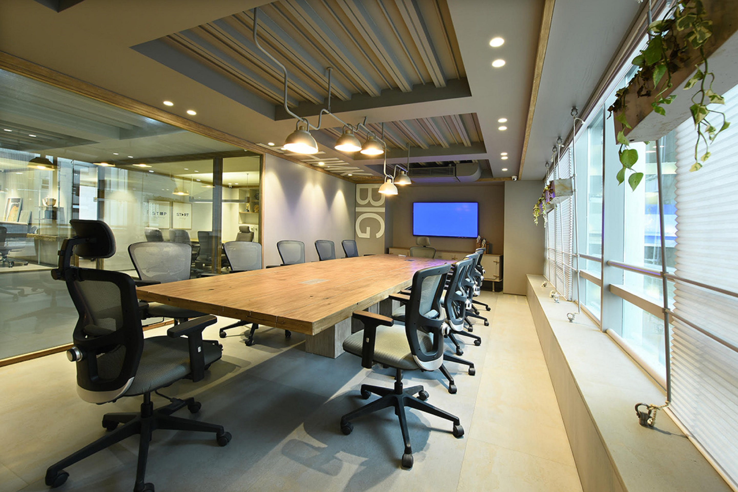



Slide 3
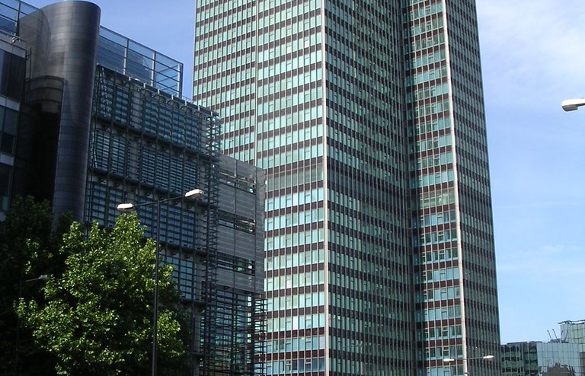

Slide 4
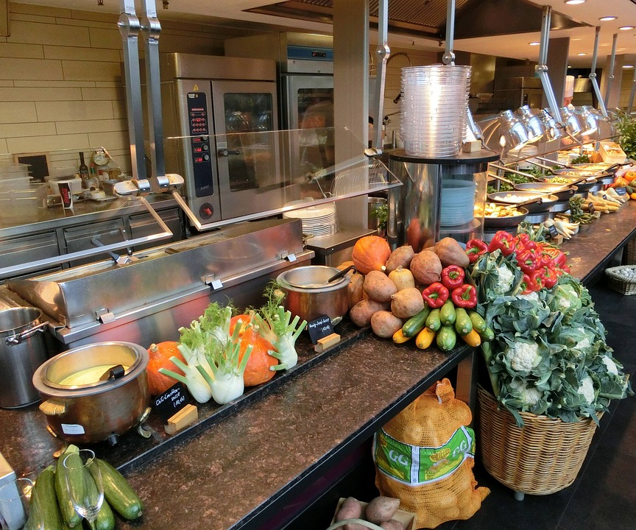
cafeteria
food

